Slide 1
RETAIL REVENUE ANALYSIS
Data-Driven Insights for Smarter Retail Decisions
Tools Used:
Excel | SQL | Python | Power BI
PRESENTED BY
R.THIRISHA

Slide 2
INTRODUCTION
Retail Revenue Analysis project focuses on analyzing retail transaction, customer, product, store, and sales data to understand overall business performance.
Using Excel, SQL, Python, and Power BI, the project transforms raw data into meaningful insights related to:
Revenue & sales performance
Customer purchasing behaviour

Slide 3
Project Objectives
Objectives
Clean and prepare retail datasets
Analyze sales and revenue trends
Identify top-performing products
Understand customer purchasing patterns
Segment customers based on their behavior
Analyze store, state, and staff performance
Identify low-stock products
Build an interactive Power BI dashboard
Support data-driven business decisions

Slide 4
PROBLEM STATEMENT
The key business challenge is to analyse fragmented retail data and identify the factors affecting revenue, sales, customer behaviour, product performance, and operational efficiency. The project addresses these challenges by using Excel, SQL, Python, and Power BI to create a consolidated and interactive revenue analysis solution.”
Business Use Cases:
1. Analyze sales performance across different stores and staff
2. Identify high-value customers and buying behavior patterns
3. Perform customer segmentation for targeted marketing
4. Monitor inventory levels and product performance
5. Create an interactive Power BI dashboard for management insights

Slide 5
TOOLS & TECHNOLOGIES
Tool | Purpose
Excel | Data cleaning, formatting & preparation
SQL | Data querying, joins & business analysis
Python | Data analysis & customer segmentation
Power BI | Interactive dashboard & visualization

Slide 6
EXCEL – DATA PREPARATION & ANALYSIS
Content:
Combined and organized the retail datasets
Cleaned and formatted the data
Removed duplicate records
Handled missing values
Standardized date and text formats
Used VLOOKUP / XLOOKUP to combine related product information
Checked sales, quantity, price and discount values
Identified and handled data inconsistencies and outliers

Slide 7
SQL ANALYSIS
Applied primary & foreign keys
Used joins between:
  Orders
  Order Items
  Products
  Customers
  Stores
  Staff
Calculated total sales/revenue
Identified top-selling products
Analyzed customer spending
Performed store and staff revenue analysis
Created customer_segments table

Slide 8
PYTHON DATA ANALYSIS
Python Tasks Completed
Imported SQL data using Pandas
Used:
  df.info()
  df.describe()
  df.value_counts()
Performed data exploration
Analyzed customer behavior using RFM features: Recency,Frequency and Monetary value.
Created customer segmentation
Generated segmentation results
Exported segmentation results for Power BI

Slide 9
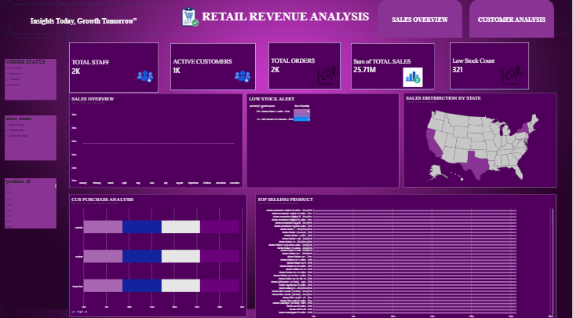
POWER BI DASHBOARD
Dashboard Features
The Power BI dashboard provides an interactive view of the retail business performance. It brings together sales, customer, product, store, staff, and inventory insights in a single dashboard.t

Slide 10
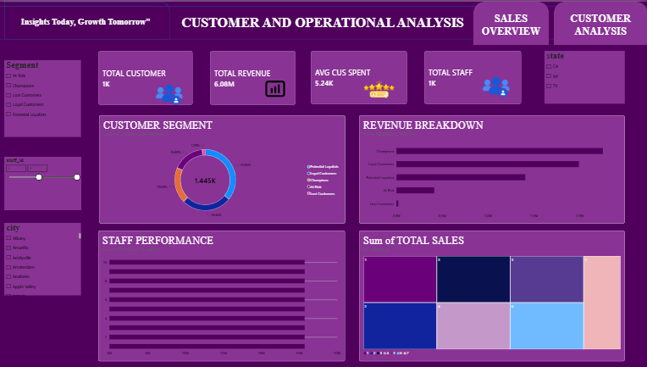

Slide 11
KEY FINDINGS
Revenue Performance: Overall revenue and sales performance were analyzed to understand business growth.
Sales Trends: Monthly and time-based analysis revealed variations in sales performance.
Product Performance: Top-selling products were identified based on sales and revenue.
Category Insights: Different product categories were compared to understand their contribution to revenue.
Customer Insights: Customer purchasing patterns and spending behaviour were analysed.
Customer Segmentation: Customers were grouped into segments based on their purchasing behaviour and value.

Slide 12
CONCLUSION
The Retail Revenue Analysis project successfully transformed raw retail data into meaningful business insights using Excel, SQL, Python, and Power
Overall, the project demonstrates how data analytics can transform complex retail data into clear and actionable business insights, helping the business understand performance and support data-driven decision-making.”

